Slide 1
Functional Dependencies and Normalization for Relational Databases

Slide 3
Chapter Outline
1 Informal Design Guidelines for Relational Databases
  1.1Semantics of the Relation Attributes
  1.2 Redundant Information in Tuples and Update Anomalies
  1.3 Null Values in Tuples
  1.4 Spurious Tuples
Functional Dependencies (FDs)
Normalisation and Normal Forms

Slide 4
Chapter Outline
1 Informal Design Guidelines for Relational Databases
  1.1Semantics of the Relation Attributes
  1.2 Redundant Information in Tuples and Update Anomalies
  1.3 Null Values in Tuples
  1.4 Spurious Tuples
2 Functional Dependencies (FDs)
  2.1 Definition of FD
  2.2 Inference Rules for FDs
  2.3 Equivalence of Sets of FDs
  2.4 Minimal Sets of FDs

Slide 5
Chapter Outline
Informal Design Guidelines for Relational Databases
Functional Dependencies (FDs)
Normal Forms

Slide 6
Informal Design Guidelines for Relational Databases (1)
What is relational database design?
  The grouping of attributes to form "good" relation schemas
Design is concerned mainly with base relations
What are the criteria for "good" base relations?

Slide 7
Semantics of the Relation Attributes
GUIDELINE 1: Informally, each tuple in a relation should represent one entity or relationship instance. (Applies to individual relations and their attributes).
  Attributes of different entities (EMPLOYEEs, DEPARTMENTs, PROJECTs) should not be mixed in the same relation

Slide 8
Semantics of the Relation Attributes
  Only foreign keys should be used to refer to other entities
  Entity and relationship attributes should be kept apart as much as possible
Bottom Line: Design a schema that can be explained easily relation by relation. The semantics of attributes should be easy to interpret.

Slide 9
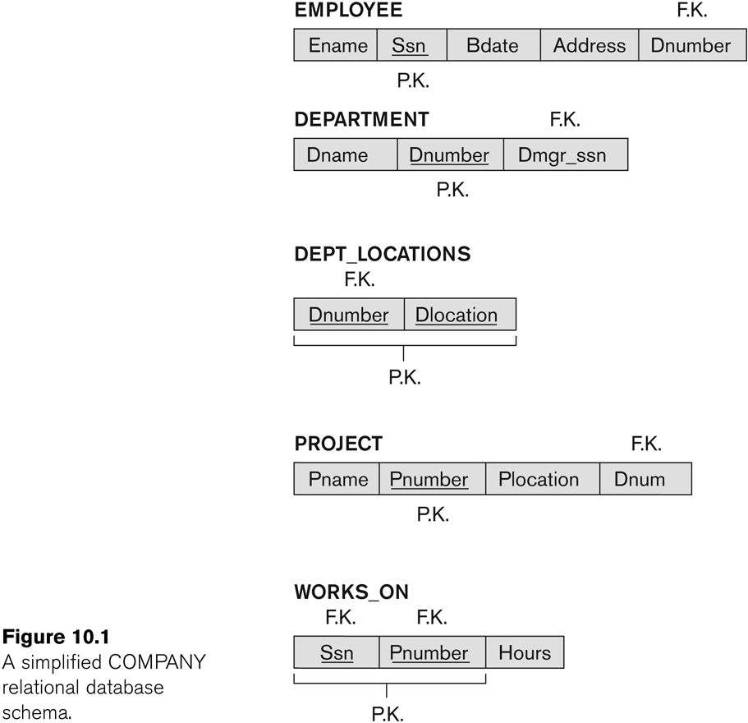
Figure 7.1 A simplified COMPANY relational database schema

Slide 10
Redundant Information in Tuples and Update Anomalies
Information is stored redundantly
  Wastes storage
  Causes problems with update anomalies
    Insertion anomalies
    Deletion anomalies
    Modification anomalies

Slide 11
EXAMPLE OF AN UPDATE ANOMALY
Consider the relation:
  EMP_PROJ(Emp#, Proj#, Ename, Pname, No_hours)
Update Anomaly:
  Changing the name of project number P1 from “Billing” to “Customer-Accounting” may cause this update to be made for all 100 employees working on project P1.

Slide 12
EXAMPLE OF AN INSERT ANOMALY
Consider the relation:
  EMP_PROJ(Emp#, Proj#, Ename, Pname, No_hours)
Insert Anomaly:
  Cannot insert a project unless an employee is assigned to it.
Conversely
  Cannot insert an employee unless an he/she is assigned to a project.

Slide 13
EXAMPLE OF AN DELETE ANOMALY
Consider the relation:
  EMP_PROJ(Emp#, Proj#, Ename, Pname, No_hours)
Delete Anomaly:
  When a project is deleted, it will result in deleting all the employees who work on that project.
  Alternately, if an employee is the sole employee on a project, deleting that employee would result in deleting the corresponding project.

Slide 14
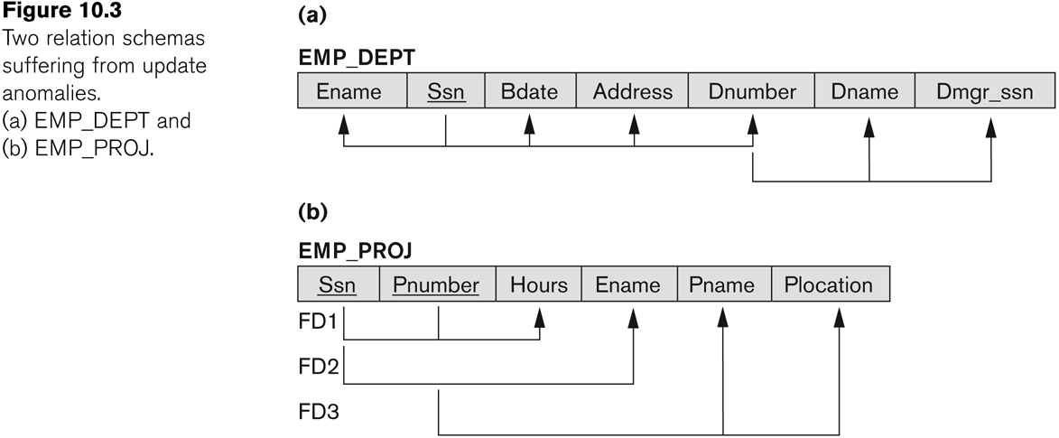
Figure 7.3 Two relation schemas suffering from update anomalies

Slide 15
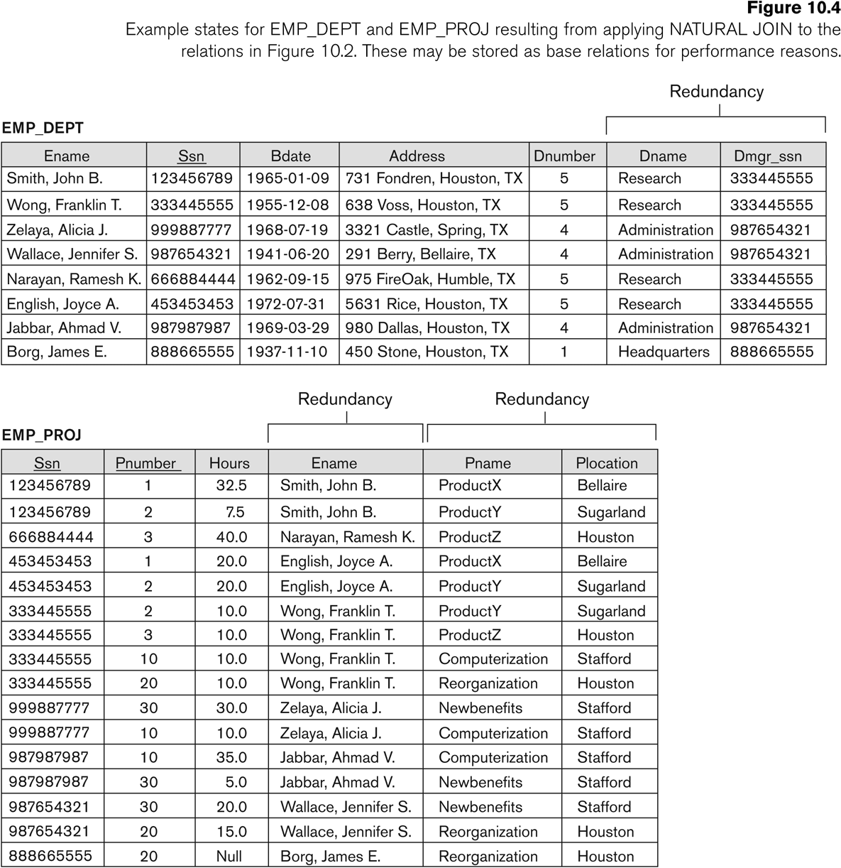
Figure 7.4 Example States for EMP_DEPT and EMP_PROJ

Slide 16
Guideline to Redundant Information in Tuples and Update Anomalies
GUIDELINE 2:
  Design a schema that does not suffer from the insertion, deletion and update anomalies.
  If there are any anomalies present, then note them so that applications can be made to take them into account.

Slide 17
Null Values in Tuples
GUIDELINE 3:
  Relations should be designed such that their tuples will have as few NULL values as possible
  Attributes that are NULL frequently could be placed in separate relations (with the primary key)
Reasons for nulls:
  Attribute not applicable or invalid
  Attribute value unknown (may exist)
  Value known to exist, but unavailable

Slide 18
Spurious Tuples
Bad designs for a relational database may result in erroneous results for certain JOIN operations
The "lossless join" property is used to guarantee meaningful results for join operations
GUIDELINE 4:
  The relations should be designed to satisfy the lossless join condition.
  No spurious tuples should be generated by doing a natural-join of any relations.

Slide 19
Spurious Tuples (2)
There are two important properties of decompositions:
  Non-additive or losslessness of the corresponding join
  Preservation of the functional dependencies.
Note that:
  Property (a) is extremely important and cannot be sacrificed.
  Property (b) is less stringent and may be sacrificed.

Slide 20
Functional Dependencies (1)
Functional dependencies (FDs)
  Are used to specify formal measures of the "goodness" of relational designs
  And keys are used to define normal forms for relations
  Are constraints that are derived from the meaning and interrelationships of the data attributes
A set of attributes X functionally determines a set of attributes Y if the value of X determines a unique value for Y

Slide 21
Functional Dependencies (2)
X -> Y holds if whenever two tuples have the same value for X, they must have the same value for Y
  For any two tuples t1 and t2 in any relation instance r(R): If t1[X]=t2[X], then t1[Y]=t2[Y]
X -> Y in R specifies a constraint on all relation instances r(R)
Written as X -> Y; can be displayed graphically on a relation schema as in Figures. ( denoted by the arrow: ).
FDs are derived from the real-world constraints on the attributes

Slide 22
Examples of FD constraints (1)
Social security number determines employee name
  SSN -> ENAME
Project number determines project name and location
  PNUMBER -> {PNAME, PLOCATION}
Employee ssn and project number determines the hours per week that the employee works on the project
  {SSN, PNUMBER} -> HOURS

Slide 23
Examples of FD constraints (2)
An FD is a property of the attributes in the schema R
The constraint must hold on every relation instance r(R)
If K is a key of R, then K functionally determines all attributes in R
  (since we never have two distinct tuples with t1[K]=t2[K])

